Slide 1
Student Results Management System
Submitted to: khan Md Hasib
Lecturer ,State University of bangladesh

Slide 2
Group Members
Nayan Saha Dip (UG02-44-17-016)
Susmoy Das (UG02-44-17-039)
Kousick Farhad (UG02-44-17-012)
Jannatul Arefin Prima (UG02-44-17-013)
Akram Hossain (UG02-41-16-044)
RM Rifat (UG02-44--0

Slide 3
Abstract:-
The project titled “STUDENT RESULT MANAGEMENT SYSTEM” is a web based application developed to maintain the results of the students.
This project contains two modules: register/login module, admin module . Admin module is used to add the students details and their results.
Registered users can access the database of the students. which will provide details about results.

Slide 4
Proposed system:-
We have successfully proposed the “STUDENT RESULT MANAGEMENT SYSTEM” for replacing the manual work of the administration.
This application is flexible and can easily access by the admin.
So the time taken for getting the information will be reduces.

Slide 5
SOFTWARE REQUIREMENTS:- OPERATING SYSTEM :WINDOWS10 FRONT END : HTML,CSS BACK END : PHP,MYSQL TOOLS :XAMPP(apache, MYSQL)

Slide 6
SYSTEM ARCHITECTURE:-
Add Student result
Student Result Management System
Search Engine
Action

Slide 7
SYSTEM ARCHITECTURE:-
Edit Student Result
Action
Delete information

Slide 8
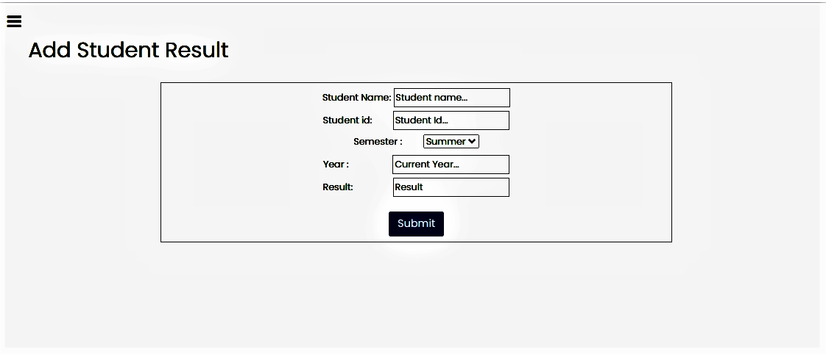

Slide 9
Edit Student Result:
Student Name
Student Id
Select Semester
Year
Result
When Admin will fill in the information's step by step and select update option . Then the information's will be updated.
Delete information :
Admin can delete the Student Information easily.

Slide 10
Modules:-
Register/Login Module
Admin Module

Slide 11
1.Resgister/login Module:-
The Home page of the “STUDENT RESULTS MANAGEMENT SYSTEM”.
It consists of admin..
Login page is used to login to the admin portal.

Slide 12
Admin Module:
Create , manage and can add their results of the students.
Update or deleting the students information

Slide 13
THANK YOU……..

